Slide 1

Action Segmentation with Temporal Convolutional Networks
Mid-Term Presentation
Volkan Okbay, METU EEE
(Istanbul AI Team)

Slide 2
Contents
Problem
Literature
Approach
Progress
Experiments
Fails & Future
References

Slide 3

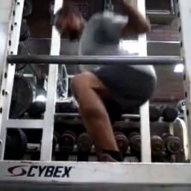
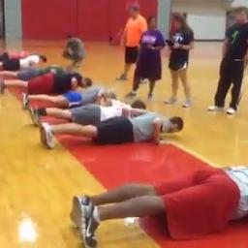

Problem - Definition
Task: Action segmentation + Edge-AI
Kinetics Dataset (Kay et.al., 2017)[4]
YouTube videos labelled with 400/600/700 classes
Challenging content, inconsistencies
We ...
Selected 4 classes (squat, pushup, pullup, situp) and some negative samples
Targeting FTHR board for real-time demonstration
Figure 1: Samples from target classes [4]

Slide 4
Problem - Dataset
Images
256x256 px
Center cropped
Videos
10sec@5fps -> 50 frames
16 frames clips
Data augmentation: more than one clip out of a video sample.
Figure 2: Data set distribution

Slide 5
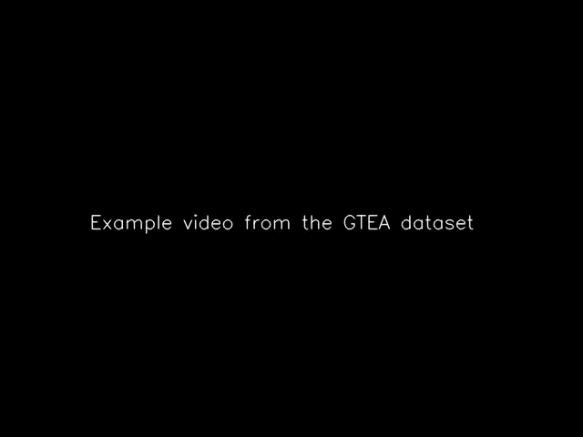
Problem – An Example
Figure 3: Output of MS-TCN (Abu Fahra, 2019) [5]

Slide 6
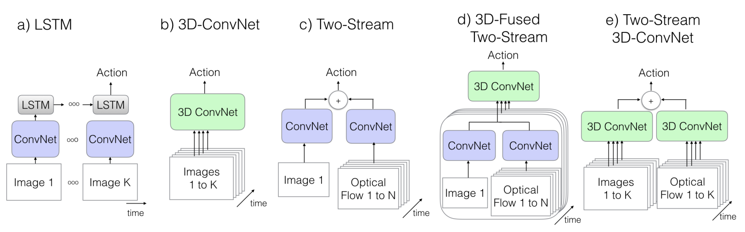
Literature
Figure 4: Common video processing approaches in deep learning [3]

Slide 7
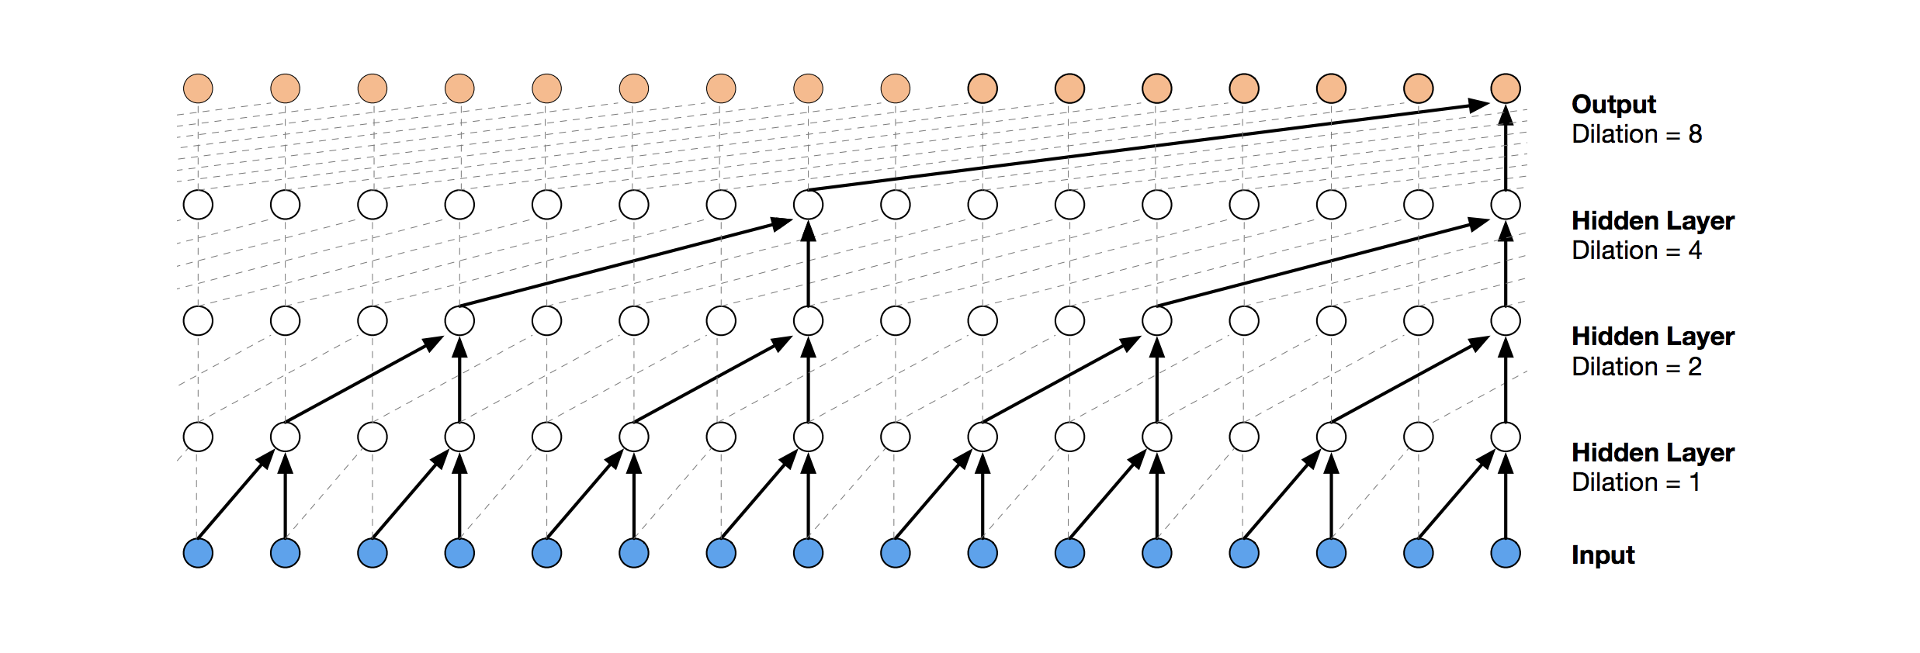
Approach – Temporal Conv Nets
Main features: dilational + causal + convolution
Figure 5: Basic TCN structure

Slide 8
Approach – Temporal Conv Nets
Advantages...
Lightweight (compared to transformers)
Prevents exploding/vanishing parameters
Trained in parallel
Disadvantage...
- Limited and fixed receptive field

Slide 9
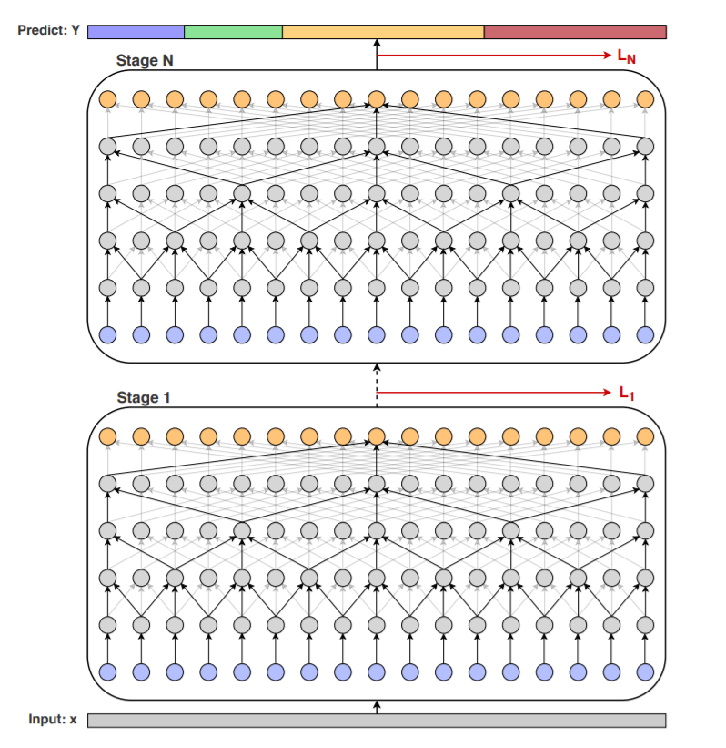
Approach – MS-TCN
Multi stage TCN
Leverages I3D frame vectors: inception based, two-stream backbone.
Only for temporal part 5 stages each with 11 layers
Figure 6: An example of TCN (Abu Fahra, 2019) [5]

Slide 10
Approach – Our Base Model
Linear
CNN
TCN
(a)
TCN
(c)
TCN
(b)
CNN: Spatial processing
13 layers
BatchNorm, ReLU & skip connections
TCN: Temporal processing
Kernel size: 5 – Dilation: 1,1,1,1
Kernel size: 3 – Dilation: 1,2,2,1
Kernel size: 3 – Dilation: 1,2,4
Linear: Classification
Figure 7: Model v1

Slide 11
Progress
General:
Workflow is created –> configured, nothing is hard-coded
Reports in log files with extensive details of training
Data:
Data augmentation after overfitting several times
Spend almost a week to make sure data is OK
Training:
Training with ai8x layers already, but without QAT
Constantly training and hyperparam tuning
Recent trainings take up to 44 hours (~14 min/epoch)

Slide 12
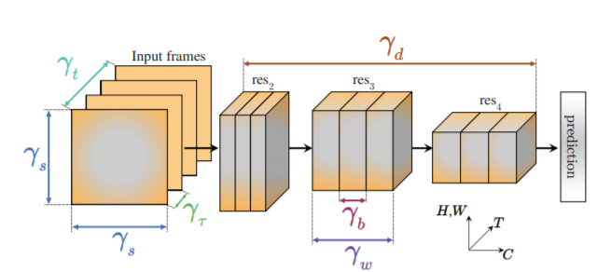
Experiments – PreTrained X3D(Medium)
Image size: 256x256
Sampling rate: 5 fps
Number of frames: 16
Number of params: 3.76M
VALIDATION ACC: 90.08%
Pull-ups | Push-up | Situp | Squat | Background
500 | 0 | 4 | 5 | 0
0 | 289 | 1 | 1 | 0
3 | 3 | 288 | 1 | 0
2 | 1 | 0 | 489 | 1
30 | 77 | 99 | 78 | 1214
Table 1: X3Dm results
Figure 8: X3D architecture [1]

Slide 13
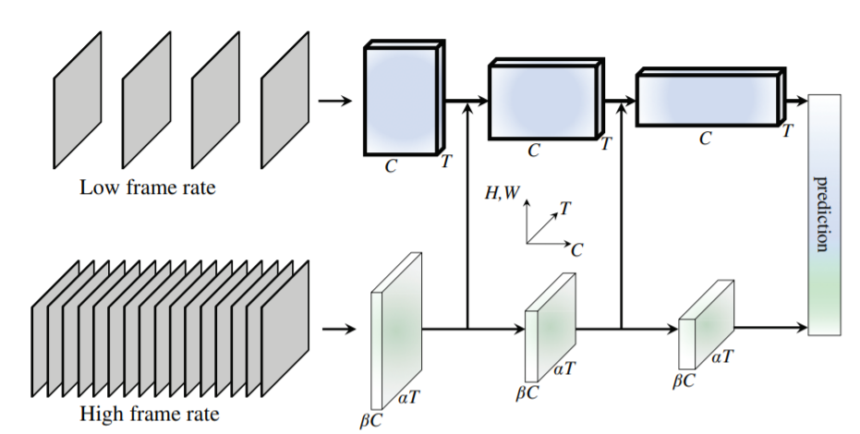
Experiments – PreTrained SlowFast(r50)
Image size: 256x256
Sampling rate: 5 fps
Number of frames: 32
Number of params: 32.9M
VALIDATION ACC: 89.32%
Pull-ups | Push-up | Situp | Squat | Background
174 | 0 | 2 | 0 | 0
1 | 103 | 0 | 1 | 0
1 | 0 | 101 | 0 | 0
0 | 1 | 0 | 147 | 0
7 | 21 | 29 | 49 | 412
Table 2: SlowFast results
Figure 9: SlowFast architecture [2]

Slide 14
Experiments – Our Base Model
Image size: 256x256
Sampling rate: 5 fps
Number of frames: 16
Number of params: 760K
VALIDATION ACC: 63.80%
Val. Acc. was around 57% before data augmentation
Clamped ai8x layers and ai8x normalization
Can overfit as much as 99%
Pull-ups | Push-up | Situp | Squat | Background
374 | 5 | 19 | 94 | 78
1 | 131 | 41 | 31 | 43
7 | 84 | 167 | 14 | 58
71 | 29 | 30 | 336 | 75
82 | 121 | 135 | 99 | 961
Table 3: Our results

Slide 15
Experiments – Hyperparameters
Learning rate and scheduling
Weight decay
Class weights
Number of frames
Number of filters, kernel size (?)
Epochs

Slide 16
Fails & Future
Fails:
Spending less time in the beginning
Results are not promising yet: overfitting or high bias
Failing at prediction classes 2&3
Future work:
Adding dropout
Adding layers
Different TCN models (e.g. MS-TCN)
Real-world demonstration (targeting above 70%)

Slide 17
References
[1] Feichtenhofer, Christoph, «X3D: Expanding Architectures for Efficient Video Recognition.» https://arxiv.org/abs/2004.04730
[2] Feichtenhofer, Christoph et. al, «SlowFast Networks for Video Recognition» https://arxiv.org/pdf/1812.03982.pdf
[3] Carreira, Joao and Zisserman, Andrew «Quo Vadis, Action Recognition? A New Model and the Kinetics Dataset» https://arxiv.org/abs/1705.07750
[4] Kay, Will, et al. «The Kinetics Human Action Video Dataset». arXiv, 19 May 2017. arXiv.org, https://doi.org/10.48550/arXiv.1705.06950
[5] Farha, Yazan Abu, and Juergen Gall. «MS-TCN: Multi-Stage Temporal Convolutional Network for Action Segmentation». arXiv, 2 Apr. 2019. arXiv.org, https://doi.org/10.48550/arXiv.1903.01945

